Slide 1
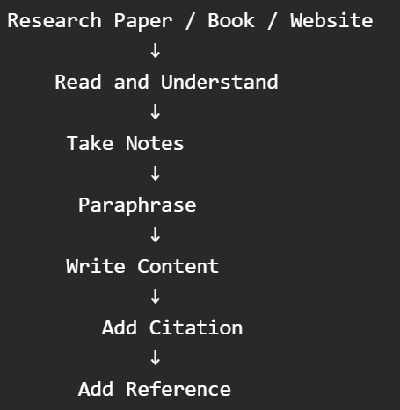
Week 1Day 5 :- Contents Creation from Research Sources
Academic writing is not copy-pasting. We read information, understand it, write it in our own words, then acknowledge the source.

Slide 2
Step 1: Finding Sources
1)Research Papers
Use:
Google Scholar
IEEE Xplore
ACM Digital Library
Springer
ScienceDirect
Example Search:
Artificial Intelligence in Education Author| Year| Title| Journal

Slide 3
Step 1: Finding Sources
2)Books
Example:
Artificial Intelligence in Education
Authors: Holmes, Bialik and Fadel
Books are useful for concepts and definitions.

Slide 4
Step 1: Finding Sources
3) Websites
Example:
UNESCO
OECD
Government websites
University websites
Avoid:
Wikipedia
Blogs without authors
Random websites

Slide 5
Step 2: Reading Sources
Don't read the whole paper first.
Look for:
Title
Abstract
Keywords
Main findings
Conclusion
What is this paper about?

Slide 6
Step 3: Taking Notes
Create a simple research note table.
Source | Main Idea
Artificial Intelligence in Education: A Review | AI is having an important impact on education and learning.
Artificial Intelligence in Education: A Review | AI can support educational processes and improve learning experiences.
Notice: Short notes Not full paragraphs copied from the paper

Slide 7
Step 4: Paraphrasing
Source Idea
The paper discusses the impact of AI on education and examines how AI can be used within educational settings.
Poor Paraphrase
Artificial Intelligence has an impact on education and can be used in educational settings.
Almost identical.
Better Paraphrase
AI technologies are increasingly influencing how students learn and how educational institutions deliver teaching and support learning activities.
Same meaning.Different wording.

Slide 8
Step 5: Writing Content for Literature Review
How notes become a paragraph.
Notes
AI affects education.
AI supports learning.
AI is becoming more common in educational environments.
Literature Review Paragraph
Artificial Intelligence has become an important technology within modern educational environments. Researchers have highlighted that AI is influencing teaching and learning practices and creating new opportunities to improve educational experiences. AI-based systems can support learning activities and assist educational institutions in delivering more effective learning services (Alam, 2021).
(Example citation format only. Students should use the exact author and year from the paper.)

Slide 9
Citation
Citations are placed throughout the report wherever information from a source is used. Whenever an idea, fact, definition, finding, statistic, theory, model, or argument comes from someone else, you should cite it, even if you write it entirely in your own words.
Example inside the Literature Review: Artificial Intelligence can support personalized learning experiences (Holmes et al., 2022).
Or The citation appears inside the paragraph, not as a chapter or heading. Holmes et al. (2022) explain that AI can support personalized learning experiences.

Slide 10
Citation
Option 1: Direct Quotation (Copying the Exact Sentence)
You can copy the exact sentence from a journal only if you put it in quotation marks and cite it.
Example
"Artificial Intelligence has an impact on education" (Alam, 2021, p. 5).
However, in most academic reports, especially undergraduate reports, too many direct quotations are discouraged.

Slide 11
Citation not needed
Methodology
This study used a Google Forms questionnaire to collect data from 30 students.
Results and Discussion
80% of respondents indicated that AI improves learning.
Do Not Cite When Your own survey results Your own observations Your own analysis Your own recommendations Your own conclusion from collected data

Slide 12
Citation needed
Cite When
Definition from a source
Idea from a source
Fact from a source
Research finding from a source
Theory from a source
Statistic from a source
Someone else's argument

Slide 13
Citation Styles
Style | Commonly Used In
Harvard | Business, Computing, Engineering, Social Sciences
APA | Psychology, Education
IEEE | Engineering, Computer Science
MLA | Literature, Humanities
Chicago | History
Vancouver | Medicine
Note
Use one citation style consistently throughout the entire report. Do not mix styles.

Slide 14
Harvard Style
AI supports personalized learning (Holmes et al., 2022).
References:
Holmes, W., Bialik, M. and Fadel, C. (2022) Artificial Intelligence in Education.
For this module, use Harvard Referencing throughout the report.
PCPS Report Writing Module
→ Use Harvard Citation
→ Use Harvard References
→ Use it consistently from Introduction to References

Slide 15
IEEE Style
AI supports personalized learning [1].
References:
[1] W. Holmes, M. Bialik and C. Fadel,
Artificial Intelligence in Education, 2022.
You must go to the References section to see who source [1] is.
Eg :-
AI supports personalized learning [1].
AI can improve accessibility for learners [2].
Here [1], and [2] are source reference numbers
Eg 2 :- If you use two sources
AI can enhance teaching and learning [1], [2].
Eg 3: Or
AI can enhance teaching and learning [1]-[3].

Slide 16
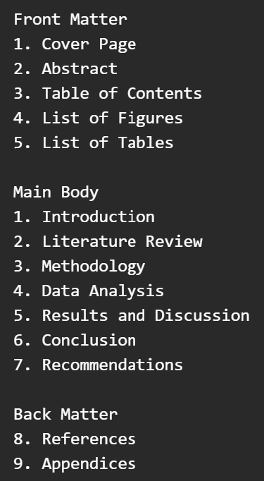
Where References Go
References are a separate section near the end of the report.

Slide 17
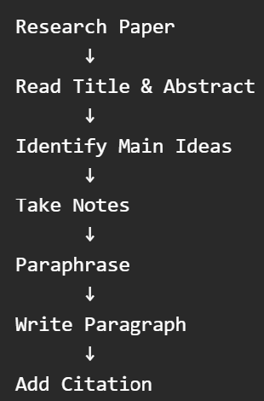
Full Process

Slide 18
Step 1 Highlight a sentence.
Eg The purpose of this study was to assess the impact of AI on education.
Step 2 Write the idea in simple words.
AI has effects on education.
Step 3 Turn it into academic writing.
Previous research has examined the influence of Artificial Intelligence on educational practices and learning environments (Alam, 2021).
Stage | Text
Original | assess the impact of AI on education
Note | AI affects education
Academic Writing | Previous research has examined the influence of AI on educational practices (Alam, 2021)

